Slide 1
Multicast
DVMRP, MOSPF, PIM

Slide 2
Multicast routing
Unicast: single source sends to a single destination
Multicast: hosts are part of a multicast group
  packet sent by any member of a group are received by all
  Efficiency and Logical Addressing
Useful for
  multiparty videoconference
  distance learning
  resource location

Slide 3
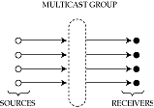
Multicast group
Associates a set of senders and receivers with each other
  but independent of them
  created either when a sender starts sending from a group
  or a receiver expresses interest in receiving
  even if no one else is there!
Sender does not need to know receivers’ identities
  rendezvous point

Slide 4
Addressing
Multicast group in the Internet has its own Class D address
  looks like a host address, but isn’t
Senders send to the address
Receivers anywhere in the world request packets from that address
“Magic” is in associating the two: dynamic directory service
Four problems
  which groups are currently active
  how to express interest in joining a group
  discovering the set of receivers in a group
  delivering data to members of a group

Slide 5
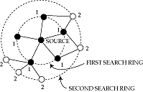
Expanding ring search
A way to use multicast groups for resource discovery
Routers decrement TTL when forwarding
Sender sets TTL and multicasts
  reaches all receivers <= TTL hops away
Discovers local resources first
Since heavily loaded servers can keep quiet, automatically distributes load

Slide 6
Multicast flavors
Unicast: point to point
Multicast:
  point to multipoint
  multipoint to multipoint
Can simulate point to multipoint by a set of point to point unicasts
Can simulate multipoint to multipoint by a set of point to multipoint multicasts
The difference is efficiency

Slide 7
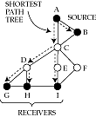
Example
Suppose A wants to talk to B, G, H, I, B to A, G, H, I
With unicast, 4 messages sent from each source
  links AC, BC carry a packet in triplicate
With point to multipoint multicast, 1 message sent from each source
  but requires establishment of two separate multicast groups
With multipoint to multipoint multicast, 1 message sent from each source,
  single multicast group

Slide 8
Shortest path tree
Ideally, want to send exactly one multicast packet per link
  forms a multicast tree rooted at sender
Optimal multicast tree provides shortest path from sender to every receiver
  shortest-path tree rooted at sender

Slide 9

Issues in wide-area multicast
Difficult because
  sources may join and leave dynamically
    need to dynamically update shortest-path tree
  leaves of tree are often members of broadcast LAN
    would like to exploit LAN broadcast capability
  would like a receiver to join or leave without explicitly notifying sender
    otherwise it will not scale

Slide 10
Multicast in a broadcast LAN
Wide area multicast can exploit a LAN’s broadcast capability
E.g. Ethernet will multicast all packets with multicast bit set on destination address
Two problems:
  what multicast MAC address corresponds to a given Class D IP address?
  does the LAN have contain any members for a given group (why do we need to know this?)

Slide 11
Class D to MAC translation
Multiple Class D addresses map to the same MAC address
Well-known translation algorithm => no need for a translation table
23 bits copied from IP address
01
00
5E
IEEE 802 MAC Address
Multicast bit
Reserved bit
Class D IP address
‘1110’ = Class D indication
Ignored

Slide 12
Internet Group Management Protocol
Detects if a LAN has any members for a particular group
  If no members, then we can prune the shortest path tree for that group by telling parent
Router periodically broadcasts a query message
Hosts reply with the list of groups they are interested in
To suppress traffic
  reply after random timeout
  broadcast reply
  if someone else has expressed interest in a group, drop out
To receive multicast packets:
  translate from class D to MAC and configure adapter

Slide 13
Wide area multicast
Assume
  each endpoint is a router
  a router can use IGMP to discover all the members in its LAN that want to subscribe to each multicast group
Goal
  distribute packets coming from any sender directed to a given group to all routers on the path to a group member

Slide 14
Simplest solution
Flood packets from a source to entire network
If a router has not seen a packet before, forward it to all interfaces except the incoming one
Pros
  simple
  always works!
Cons
  routers receive duplicate packets
  detecting that a packet is a duplicate requires storage, which can be expensive for long multicast sessions

Slide 15

A clever solution
Reverse path forwarding
Rule
  forward packet from S to all interfaces if and only if packet arrives on the interface that corresponds to the shortest path to S
  no need to remember past packets
  C need not forward packet received from D

Slide 16

Cleverer
Don’t send a packet downstream if you are not on the shortest path from the downstream router to the source
  How do you know that – one approach is RPB like
C need not forward packet from A to E
Potential confusion if downstream router has a choice of shortest paths to source (see figure on previous slide)

Slide 17
Pruning
RPF/B does not completely eliminate unnecessary transmissions
B and C get packets even though they do not need it
Pruning => router tells parent in tree to stop forwarding
  Can infer using routing tables (split horizon w/ poisonous reverse) and membership reports
Can be associated either with a multicast group or with a source and group
  trades selectivity for router memory (#groups x #sources in group)

Slide 18
Rejoining
What if host on C’s LAN wants to receive messages from A after a previous prune by C?
  IGMP lets C know of host’s interest
  C can send a join(group, A) message to B, which propagates it to A
  or, periodically flood a message; C refrains from pruning

Slide 19
DVMRP
Distance-vector Multicast routing protocol
Very similar to RIP
  distance vector
  hop count metric
Used in conjunction with
  flood-and-prune (to determine memberships)
    NMR/prunes store per-source and per-group information, aging of NMRs,
  reverse-path forwarding (to decide where to forward a packet)
  explicit cancel NMR messages to reduce join latency (but no source info, so still need flooding) and handle topology changes

Slide 20

A problem
Reverse path forwarding requires a router to know shortest path to a source
  known from routing table
Doesn’t work if some routers do not support multicast
  virtual links between multicast-capable routers
  shortest path to A from E is not C, but F

Slide 21
A problem (contd.)
Two problems
  how to build virtual links
  how to construct routing table for a network with virtual links

Slide 22
Tunnels
Why do we need them?
Consider packet sent from A to F via multicast-incapable D
If packet’s destination is Class D, D drops it
If destination is F’s address, F doesn’t know multicast address!
So, put packet destination as F, but carry multicast address internally
Encapsulate IP in IP => set protocol type to IP-in-IP

Slide 23
Multicast routing protocol
Interface on “shortest path” to source depends on whether path is real or virtual
Shortest path from E to A is not through C, but F
  so packets from F will be flooded, but not from C
Need to discover shortest paths only taking multicast-capable routers into account
  DVMRP

Slide 24
MOSPF
Multicast extension to OSPF
Routers flood group membership information with LSPs
Each router independently computes shortest-path tree that only includes multicast-capable routers
  no need to flood and prune
Complex
  interactions with external and summary records
  need storage per group per link
  need to compute shortest path tree per source and group

Slide 25
Core-based trees
Problems with DVMRP-oriented approach
  need to periodically flood and prune to determine group members
  need to source per-source and per-group prune records at each router
  Charge routers not involved in multicast
  Dependence on similarity of multicast/unicast algorithms across Internet.
Key idea with core-based tree
  coordinate multicast with a core router
    Each core router allowed 2^32 groups
  host sends a join request to core router
    Name to (coreid,groupid) resolution via a directory service
  routers along path mark incoming interface for forwarding

Slide 26
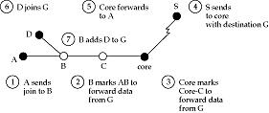
Example
Pros
  routers not part of a group are not involved in pruning
  explicit join/leave makes membership changes faster
  router needs to store only one record per group
Cons
  all multicast traffic traverses core, which is a bottleneck
  traffic travels on non-optimal paths (delay CBT/SPT <= 2, from Wall 1980. Simulations in Deering96 show 1.4)
    Core placement ?

Slide 27
Protocol independent multicast (PIM)
Tries to bring together best aspects of CBT and DVMRP
Desiderata
    Efficient Sparse Group Support, Low delay data distribution, independence from underlying unicast, robustness to routing changes, interoperability with DVMRP/MOSPF
Choose different strategies depending on whether multicast tree is dense or sparse
  flood and prune good for dense groups
    only need a few prunes
    CBT needs explicit join per source/group
  CBT good for sparse groups
Dense mode PIM == DVMRP
Sparse mode PIM is similar to CBT
  but receivers can switch from CBT to a shortest-path tree

Slide 28
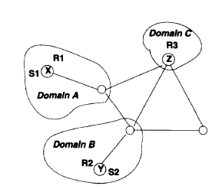
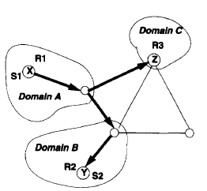
PIM basics

Slide 29
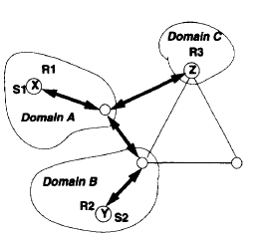
PIM basics

Slide 30
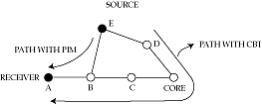
PIM (contd.)
In CBT, E must send to core
In PIM, B discovers shorter path to E (by looking at unicast routing table)
  sends join message directly to E
  sends prune message towards core
Core no longer bottleneck
Survives failure of core

Slide 31
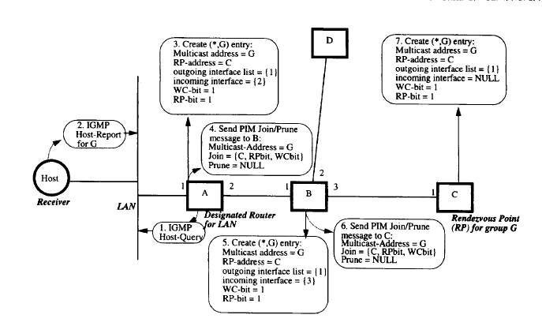

Slide 32
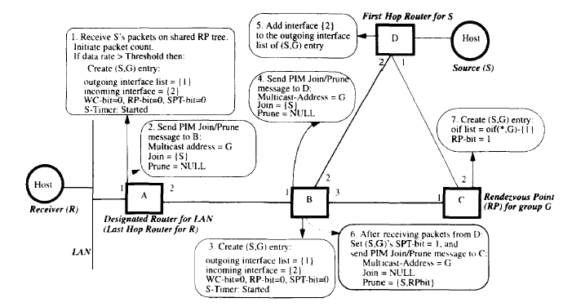

Slide 33
More PIM
rendezvous point is sort of like Core in CBT
  because it no longer carries all the traffic like a CBT core
Rendezvous points periodically send “I am alive” messages downstream
Leaf routers set timer on receipt
If timer goes off, send a join request to alternative rendezvous point
Problems
  how to decide whether to use dense or sparse mode?
  how to determine “best” rendezvous point?

Slide 34
Routing vs. policy routing
In standard routing, a packet is forwarded on the ‘best’ path to destination
  choice depends on load and link status
With policy routing, routes are chosen depending on policy directives regarding things like
  source and destination address
  transit domains
  quality of service
  time of day
  charging and accounting
The general problem is still open
  fine balance between correctness and information hiding

Slide 35
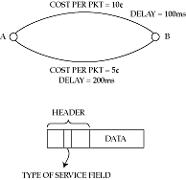
Multiple metrics
Simplest approach to policy routing
Advertise multiple costs per link
Routers construct multiple shortest path trees

Slide 36
Problems with multiple metrics
All routers must use the same rule in computing paths
Remote routers may misinterpret policy
  source routing may solve this
  but introduces other problems (what?)

Slide 37
Provider selection
Another simple approach
Assume that a single service provider provides almost all the path from source to destination
  e.g. AT&T or MCI
Then, choose policy simply by choosing provider
  this could be dynamic (agents!)
In Internet, can use a loose source route through service provider’s access point
Or, multiple addresses/names per host

Slide 38

Crankback
Consider computing routes with QoS guarantees
Router returns packet if no next hop with sufficient QoS can be found
In ATM networks (PNNI) used for the call-setup packet
In Internet, may need to be done for _every_ packet!
  Will it work?

